Slide 1

Notes:
Hi Everyone,
Good Morning
Before we start with the presentation today, I would like to share a small recital.
We have been a part of Publicis Sapient for almost 3months now, and there is this fact that everyone of us would agree upon.
We all started as fresh graduates, underwent 5weeks or so of rigorous training followed by what…5 weeks now of a Hands On project, and what has transpired in these days is a fact that we all are really proud of. A transformation from someone who could code, to someone who can not only code, but add value to everything he does.
So have we succeeded at becoming a Product engineer?
Hi, I am Rajat, a small part of our big team here.
I am here with my colleagues Aman and Chinmay and we are here to give you a walkthrough of our Transformation, our Journey and the project we have been working for sometime now.

Slide 2
1
The Ask – Where we started?
…..

Slide 3
Framework for 1.5 Weeks
1.5 weeks plan
EveryDay Discussion about topics / Technologies / doubt clearance .
Every day with SME/Trainer discussion of Project progress and transformation based on UML and Technologies

Slide 4
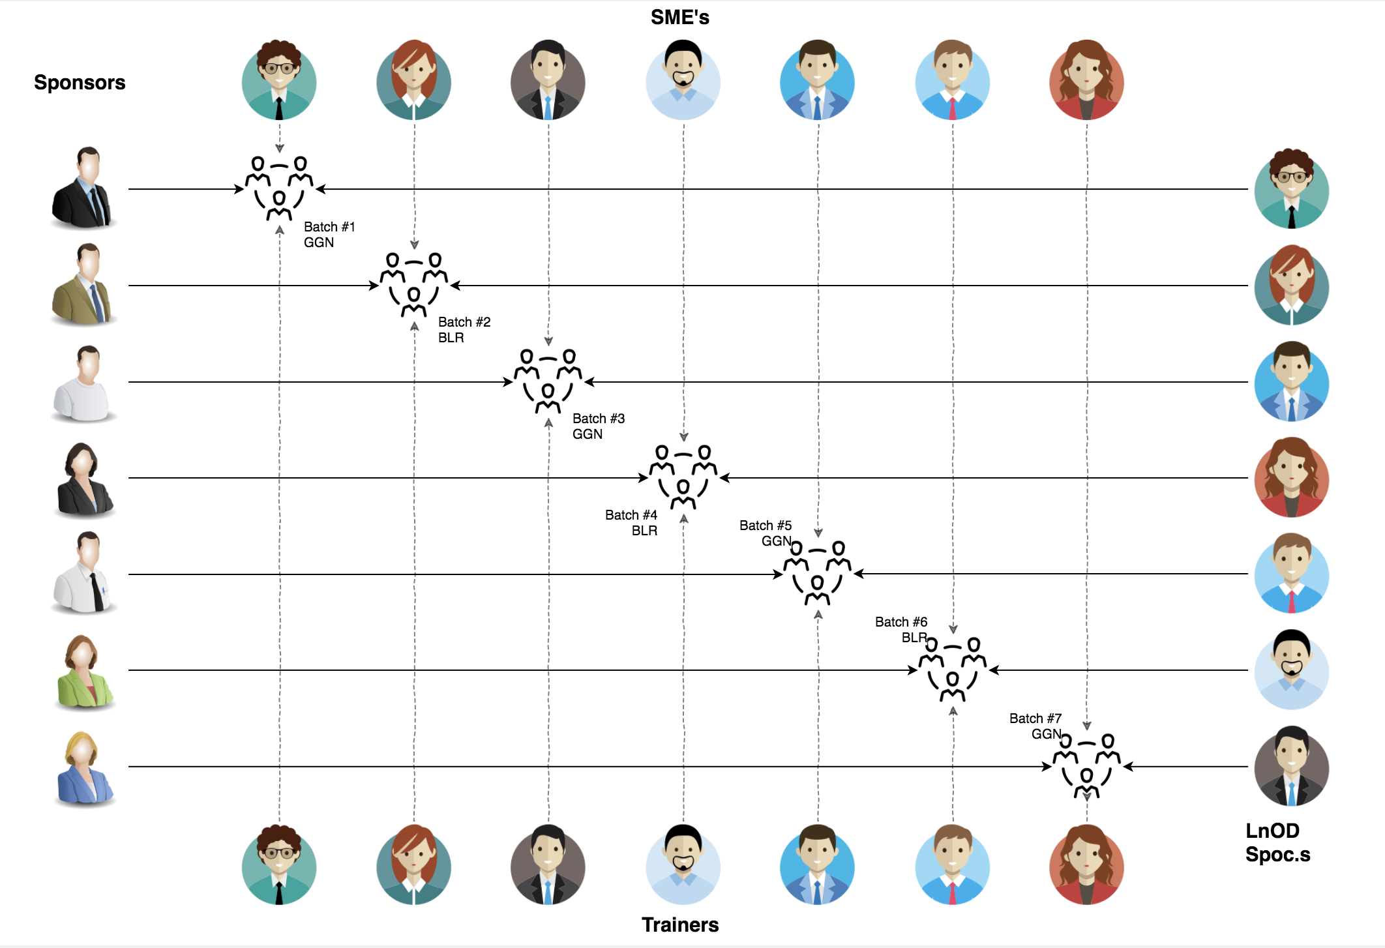
Stakeholders
Sponsors
TCS
SME’s
1. Amit Balyan
Coordinators
Prudhvi

Slide 5
Our next starts
NOW
Notes:
Time – 1 min
Swati

Slide 6
1.5 WEEKS OF TRAINING + PROJECT DEMO
10 DAYS
240 HOURS
14,400 MINUTES
8,64,000 SECONDS
LIMITLESS KNOWLEDGE

Slide 7

Agenda
01
Our Journey
02
Our Team
03
Team Structure
04
Project Goals
05
Engineering Practices
06
Tech Stack
07
Development
08
Challenges & Learnings
09
Demo
10
Questions
Notes:
Time – 1 min

Slide 8
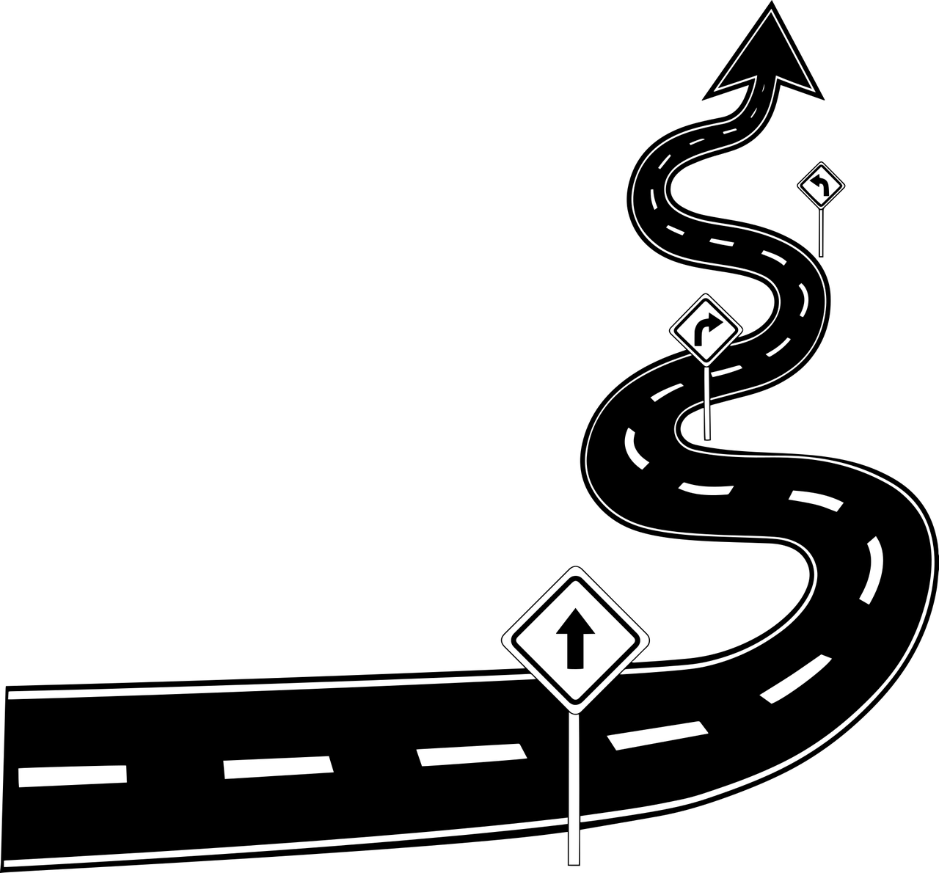
Our Journey
Notes:
Time - 2 mins

Slide 9
Demo
Mindset
Process
5
project Demo
Tools
4
Adapting to a developer
Mindset
Comprehend
3
Design Thinking
2
Decide the Technologies JAVA/REST
1
Understanding Project Goals

Slide 10

Our Team
Notes:
Time – 2 mins

Slide 11
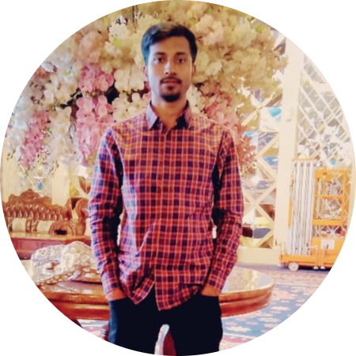
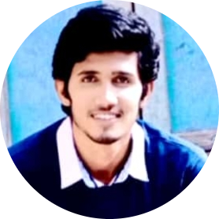
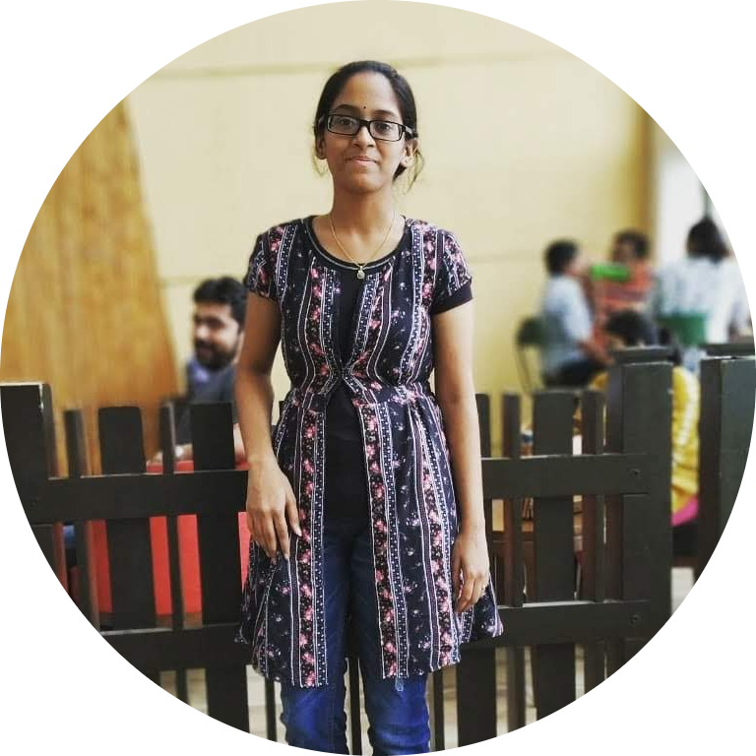
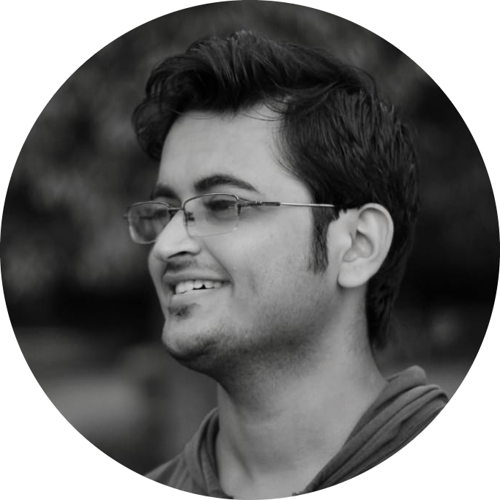
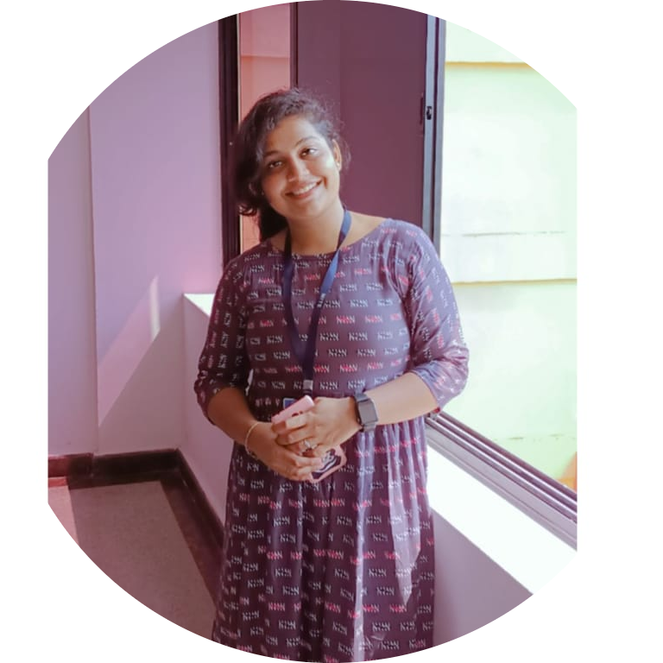
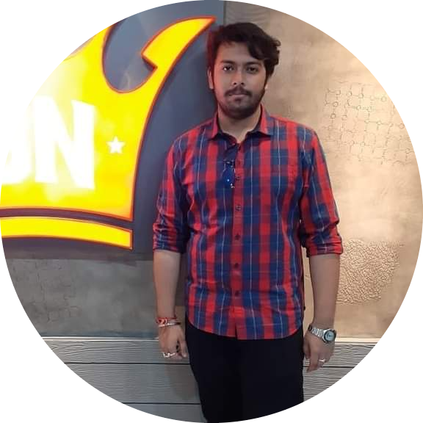
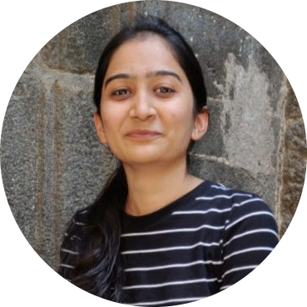
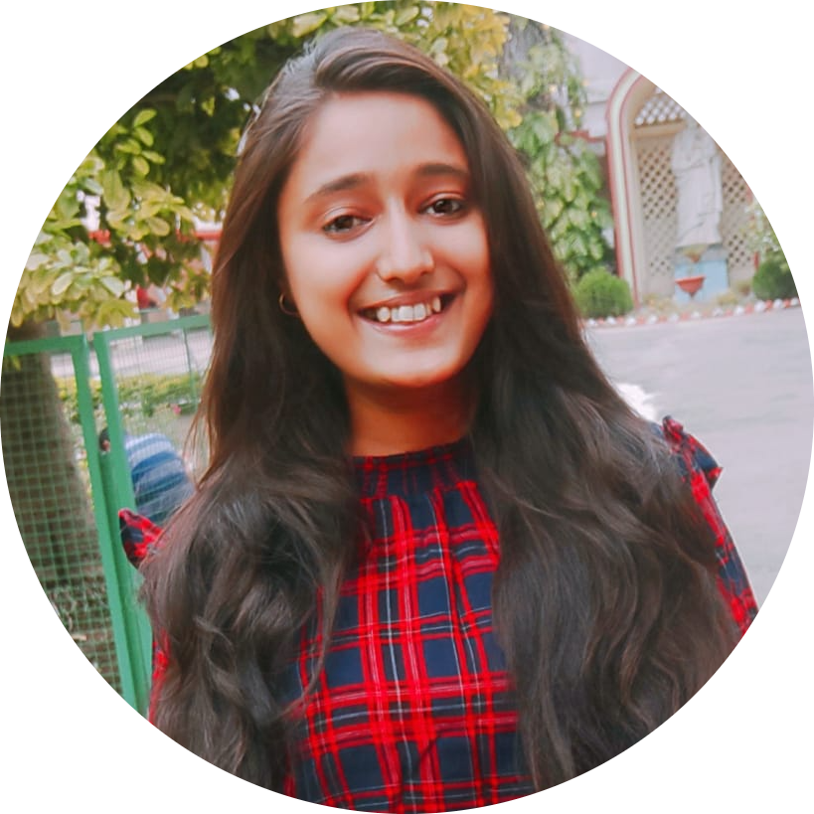
Aniket
Pune
Sashank
Bangalore
Hema Sundar
Hyderabad
Vaidehi
Hyderabad
Sushmita
Bangalore
Tuhin
Pune
Sanjana
Pune
Sonali
Pune

Slide 12

Project Goals
Notes:
Time – 3 mins

Slide 13




Our Vision
To create a Course Registration System using JAVA/REST tools and technologies, where a professor as well as a student can view courses and enroll in some of the courses.
1
2
Quality
Security
3
4
Interactivity
Speed
Notes:
User satisfaction and brand value

Slide 14

Engineering Practices
Notes:
Time – 5 mins

Slide 15
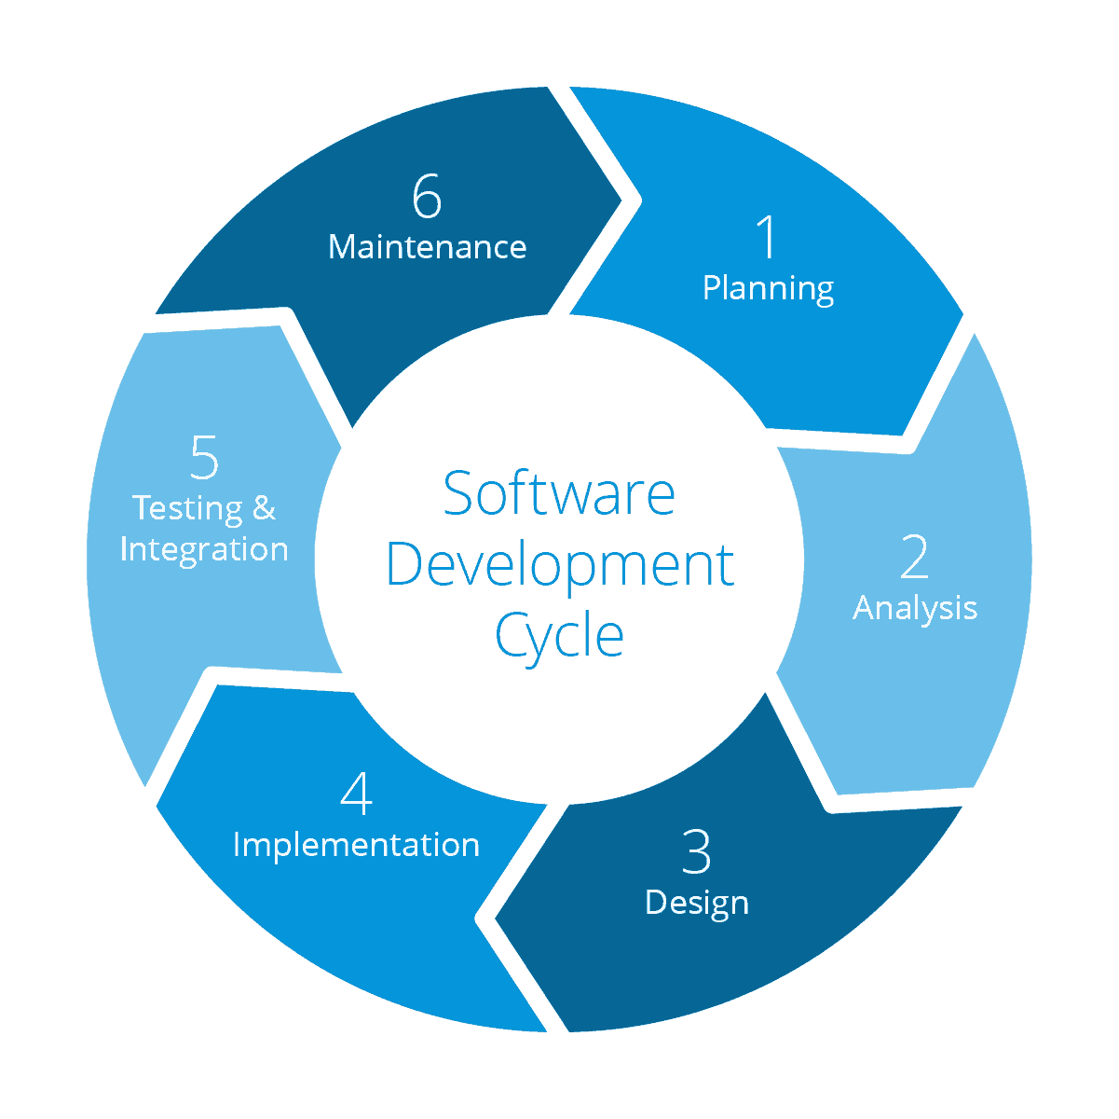
Requirement gathering
System Testing
Technology stack selection
Code implementation and development
UML artifacts design

Slide 16
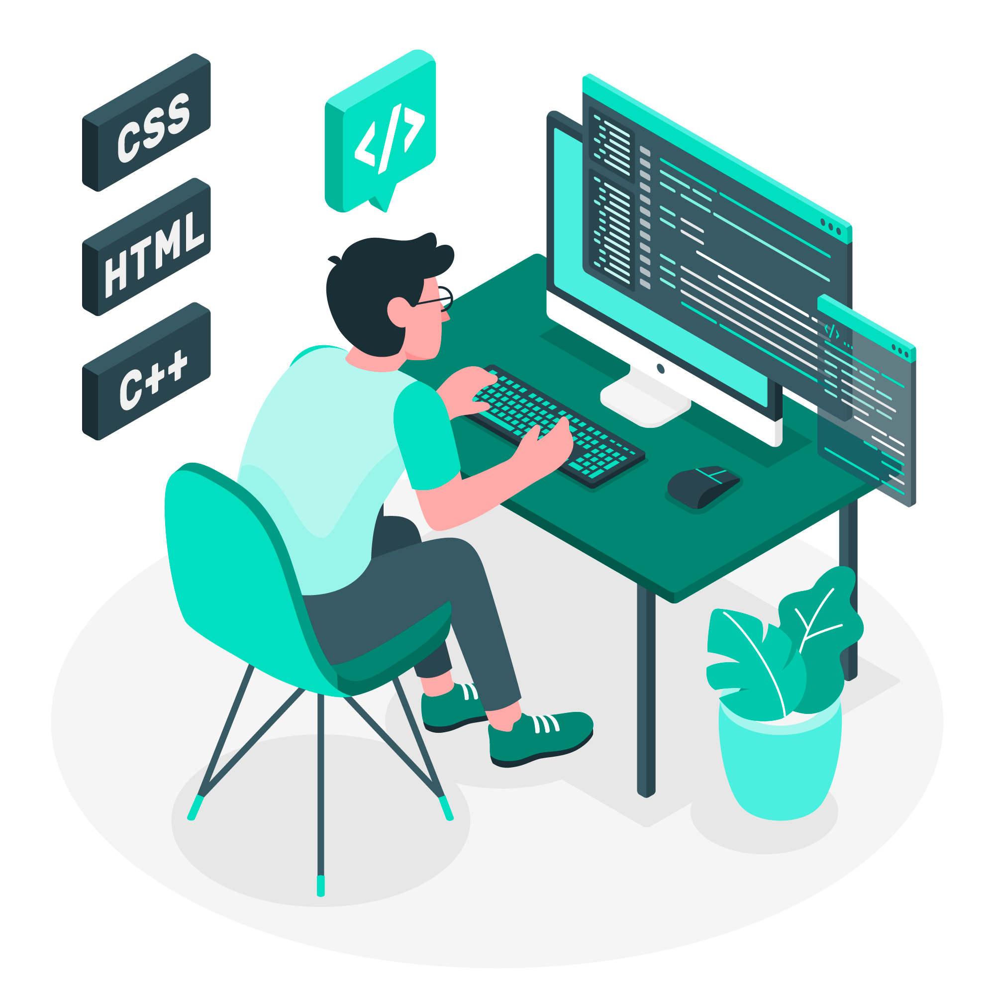
Tech Stack
Notes:
Time – 2 mins

Slide 17
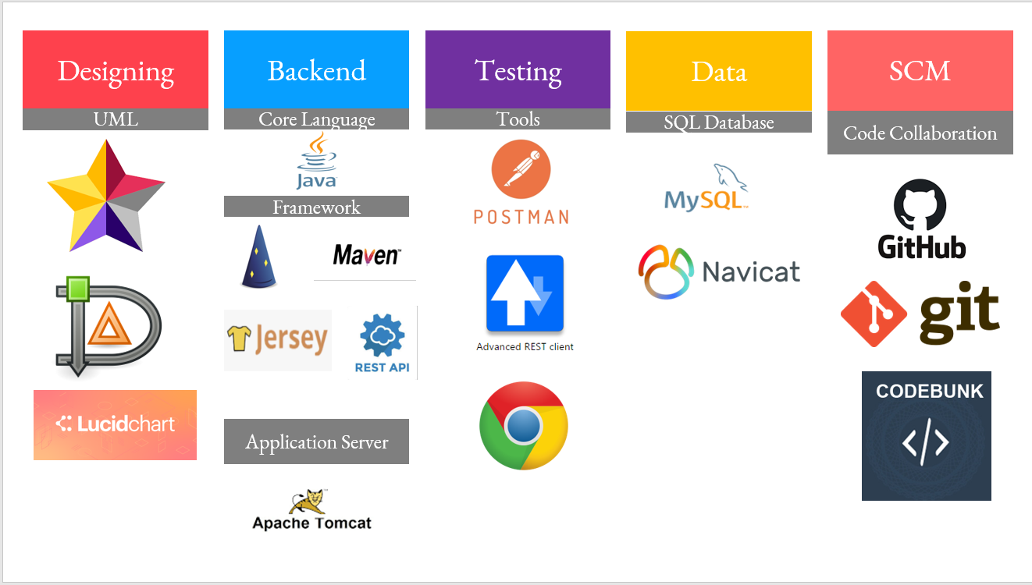


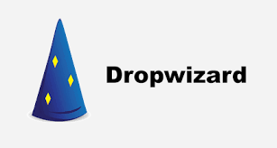


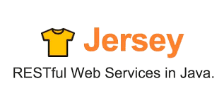



Infra
Backend
Data
Tools
Framework
Automation Tool
Story Management
Core Language
NoSQL Database
Framework
SQL Database
Documentation
SCM
Application Server
Notes:
Time – 1 min

Slide 18

Demo

Slide 19

Challenges & Learnings
Notes:
Time – 2 mins
Challenges-
Installing the Tomcat server and running application on it.
Learnings-
Got to learn new technologies.
Learnt working together in teams.(collaboration)
Learnt how to write code which is accepted by the industry.
Learnt how to make UML diagrams for the given problem.

Slide 20
Thank you
Notes:
Time – After this show the testimonial video. 1 min

